Slide 1
Hito 2 - PGM
Estudiante: Isaac Herrera Mareño

Slide 2
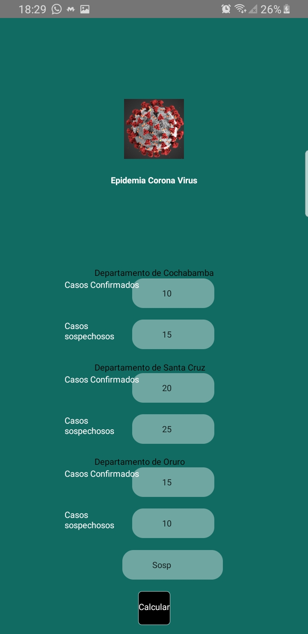
Construcción del componente CVLogo.
import React, {Component} from 'react'
import {
StyleSheet,
View,
Text,
Image
} from 'react-native';
import Logo from '../../img/virus.jpg';
export default class logo extends Component{
constructor(props){
super(props);
}
render(){
return(
<>
<View style={styles.container}>
<Image source={Logo} style={styles.image}/>
<Text style={styles.text}>
Epidemia Corona Virus
</Text>
</View>
</>
);
}
}
const styles = StyleSheet.create({
container:{
flex:1,
alignItems:'center',
justifyContent:'center',
},
image:{
width:80,
height:80,
},
text:{
color:'white',
fontWeight:'bold',
backgroundColor:'transparent',
marginTop:20,
}
})

Slide 3
Construcción del componente CVCasos.
import React, {Component, useState} from 'react';
import {StyleSheet,View,Text,TextInput,Image} from 'react-native';
import PropTypes from 'prop-types';
import Colors from '../../Config/Colors';
import constants from '../../Config/constants';
export default class CVcasos extends Component {
constructor(props){
super(props);
}
render(){
return(
<View>
<TextInput
style={stylesTextInput.textInput}
onChangeText={this.props.onChangeText}
selectionColor={Colors.blue}
placeholder={constants.CONFIRMA}
secureTextEntry={this.props.secureTextEntry}
autoCorrect={this.props.autoCorrect}
placeholderTextColor={"#ffffff"}
underlineColorAndroid="transparent"
/>
<TextInput
style={stylesTextInput.textInput}
onChangeText={this.props.onChangeText}
selectionColor={Colors.blue}
placeholder={constants.SOSPECHA}
secureTextEntry={this.props.secureTextEntry}
autoCorrect={this.props.autoCorrect}
placeholderTextColor={"#ffffff"}
underlineColorAndroid="transparent"
/>
</View>
);
}
}
CVcasos.propTypes={
onChangeText: PropTypes.func.isRequired,
placeholder: PropTypes.string.isRequired,
autoCorrect: PropTypes.bool,
secureTextEntry: PropTypes.bool,
};
const stylesTextInput = StyleSheet.create({
textInput: {
backgroundColor: 'rgba(255, 255, 255, 0.4)',
alignItems: 'center',
height: 40,
borderColor: Colors.silver,
paddingLeft: 40,
borderRadius: 15,
borderBottomWidth: StyleSheet.hairlineWidth,
marginBottom: 15,
marginLeft:50,
},
inlineImg: {
position: 'absolute',
zIndex: 99,
width: 22,
height: 22,
left: 10,
top: 9,
},
texto:{
borderColor:Colors.white,
color:'white',
fontWeight:'bold',
backgroundColor:'transparent',
},
container:{
alignItems:'center',
justifyContent:'center',
},
});

Slide 4
Construcción del componente CVCiudad.
import React from 'react';
import {StyleSheet,View,Text} from 'react-native';
import PropTypes from 'prop-types';
import Colors from '../../Config/Colors';
import CVcasos from '../../Components/corona/CVcasosing';
import Constants from '../../Config/constants';
const CVciudad=(props)=> {
const {ciudad,onChangeTextConf,onChangeTextSosp}=props;
return(
<View>
<Text>{ciudad}</Text>
<CVcasos
onChangeText={onChangeTextConf}
placeholder={Constants.nro}
autoCorrect={false}
secureTextEntry={false}
typeCase={Constants.CONFIRMA}
/>
<CVcasos
onChangeText={onChangeTextSosp}
placeholder={Constants.nro}
autoCorrect={false}
secureTextEntry={false}
typeCase={Constants.SOSPECHA}
/>
</View>
)
};
const styles = StyleSheet.create({
text:{
position: 'absolute',
fontWeight:'bold',
color: Colors.black,
},
});
export default CVciudad;

Slide 5
Construcción del componente CVscreen.
import React, { Component } from 'react';
import { StyleSheet, View, TextInput } from 'react-native';
import Button from '../../Components/corona/Button';
import Casosinput from '../../Components/corona/TextInput';
import CVciudad from '../../Components/corona/CVciudading';
import LogoLogin from '../../Components/corona/CVlogo';
import Constants from '../../Config/constants';
import Colors from '../../Config/Colors';
import imgUsername from '../../../src/img/background.jpg';
import ciudades from '../../Config/ciudades';
export default class CVscreening extends Component {
constructor(props) {
super(props);
this.state = {
confCB: 0,
sospCB: 0,
confSC: 0,
sospSC: 0,
confOR: 0,
sospOR: 0,
search: ' '
};
this._onChangeTextConfCB = this._onChangeTextConfCB.bind(this);
this._onChangeTextSospCB = this._onChangeTextSospCB.bind(this);
this._onChangeTextConfSC = this._onChangeTextConfSC.bind(this);
this._onChangeTextSospSC = this._onChangeTextSospSC.bind(this);
this._onChangeTextConfOR = this._onChangeTextConfOR.bind(this);
this._onChangeTextSospOR = this._onChangeTextSospOR.bind(this);
this._onChangeTextInputSearch = this._onChangeTextInputSearch.bind(this);
this._onPressCalcular= this._onPressCalcular.bind(this);
}
_onChangeTextConfCB(confCB) {
this.setState({
confCB: confCB
});
}
_onChangeTextSospCB(sospCB) {
this.setState({
sospCB: sospCB
});
}
_onChangeTextConfSC(confSC) {
this.setState({
confSC: confSC
});
}
_onChangeTextSospSC(sospSC) {
this.setState({
sospSC: sospSC
});
}
_onChangeTextConfOR(confOR) {
this.setState({
confOR: confOR
});
}
_onChangeTextSospOR(sospOR) {
this.setState({
sospOR: sospOR
});
}
_onChangeTextInputSearch(search){
this.setState({
search: search
});
}
_onPressCalcular(){
let n1CB, n2SC, n3OR, busqueda;
if ( this.state.search === 'Conf'){
n1CB= parseInt(this.state.confCB);
n2SC= parseInt(this.state.confSC);
n3OR= parseInt(this.state.confOR);
}
if (this.state.search === 'Sosp'){
n1CB=parseInt(this.state.sospCB);
n2SC= parseInt(this.state.sospSC);
n3OR= parseInt(this.state.sospSC);
}
let mayor = Math.max(n1CB, n2SC, n3OR);
console.log('boton calcular');
console.log(this.state);
console.log(mayor);
}

Slide 6
render() {
return (
<View style={styles.container}>
<LogoLogin style={styles.logo} />
<View>
<CVciudad
ciudad={ciudades.COCHA}
onChangeTextConf={this._onChangeTextConfCB}
onChangeTextSosp={this._onChangeTextSospCB}>
</CVciudad>
<CVciudad
ciudad={ciudades.SANTA}
onChangeTextConf={this._onChangeTextConfSC}
onChangeTextSosp={this._onChangeTextSospSC}>
</CVciudad>
<CVciudad
ciudad={ciudades.ORURO}
onChangeTextConf={this._onChangeTextConfOR}
onChangeTextSosp={this._onChangeTextSospOR}>
</CVciudad>
</View>
<TextInput
style={styles.textInput}
onChangeText={this._onChangeTextInputSearch}
selectionColor={Colors.blue}
placeholder={Constants.BUSQUEDA}
secureTextEntry={false}
autoCorrect={false}
placeholderTextColor={"#ffffff"}
underlineColorAndroid="transparent"
/>
<Button
onPress={this._onPressCalcular}
titleButton={Constants.CALCULAR}
/>
</View>
);
}
}
const styles = StyleSheet.create({
container: {
flex: 1,
backgroundColor: Colors.red,
alignItems: 'center',
justifyContent: 'space-between',
},
logo: {
flex: 1,
width: '100%',
resizeMode: 'contain',
alignSelf: 'center',
},
form: {
flex: 1,
justifyContent: 'center',
width: '80%',
marginTop: 100,
},
textInput: {
backgroundColor: 'rgba(255, 255, 255, 0.4)',
alignItems: 'center',
height: 40,
borderColor: Colors.red,
paddingLeft: 40,
borderRadius: 15,
borderBottomWidth: StyleSheet.hairlineWidth,
marginBottom: 15,
marginLeft:50,
},
});

Slide 7
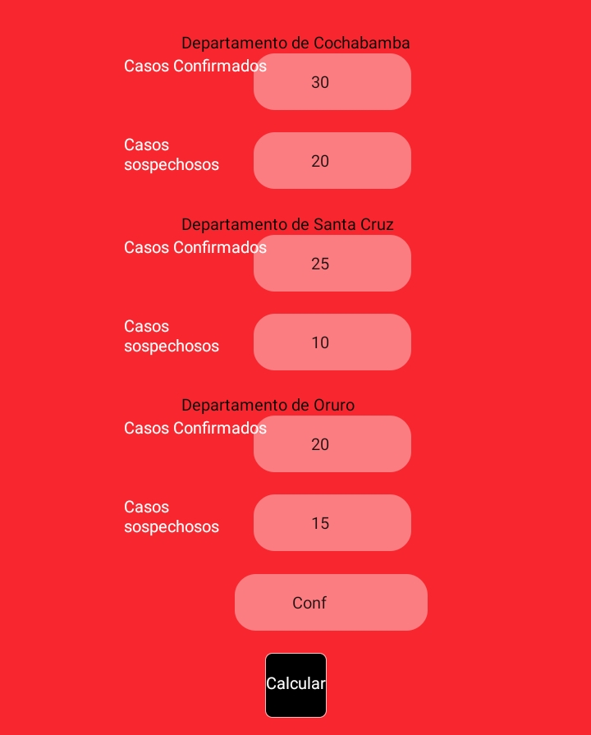
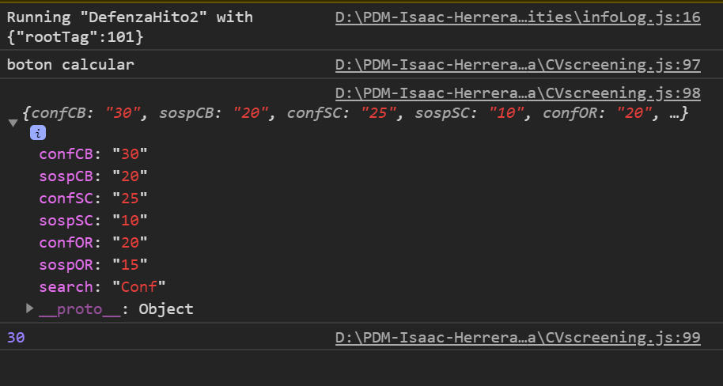
Pruebas de funcionamiento (Sosp)

Slide 8
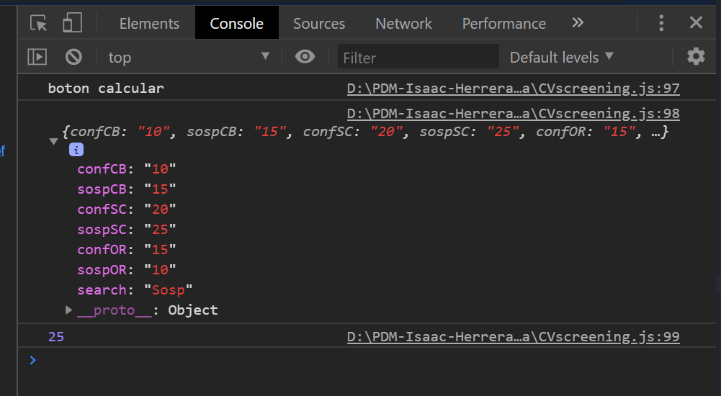
Pruebas de funcionamiento (Sosp)

